Slide 1

Step by step manual on EVER membership registration

Slide 2


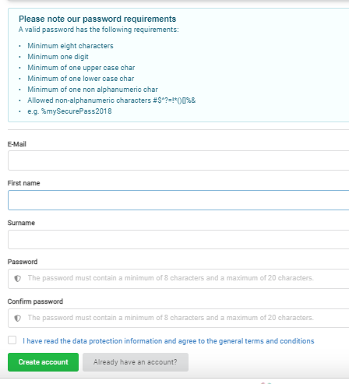
As first step you will need to create a new account to begin your registration for EVER membership*
On your first log in you will be asked to create new credentials
Please remember this password as you will need it to log on to the EVER webpage
Please tick the box confirming the terms & conditions and click on the create account button.
*If you had previously created an account with the M-anage platform please see the following slide

Slide 3



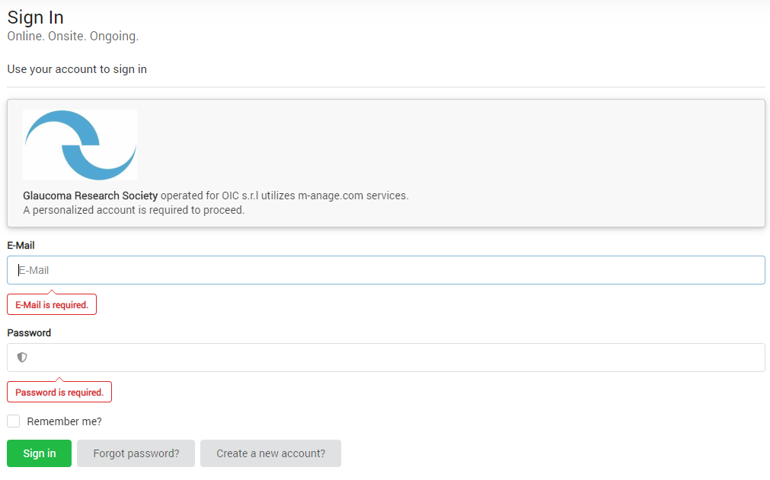
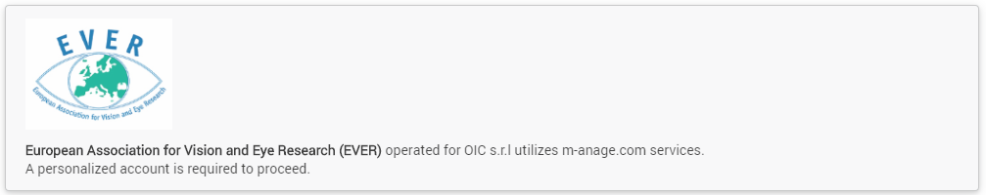
Only for EVER members with an existing M-anage account (otherwise please skip this slide)
If you had previously created an account with the M-anage platform, you will be directed to the following log in screen.
Please click on the log in box and insert your own credentials; if you do not remember them please use the forgot password option.

Slide 4
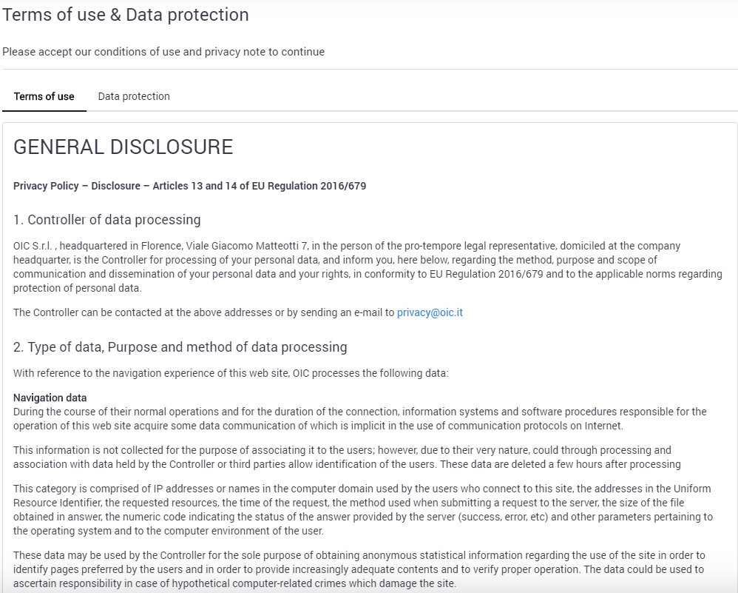
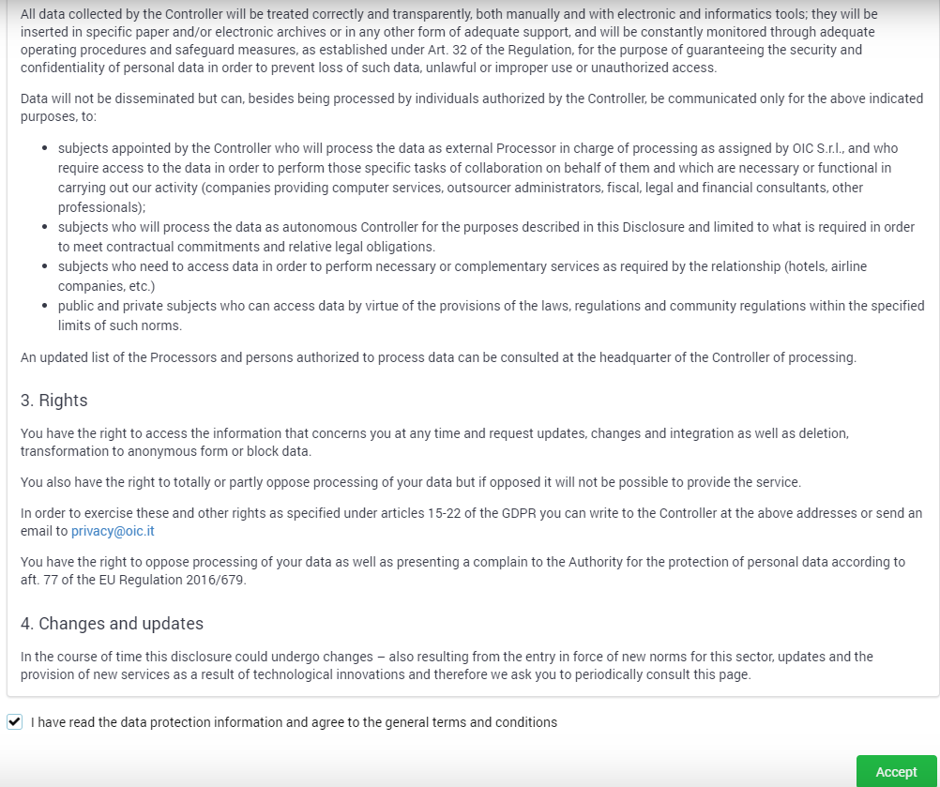
Please read the general disclosure and accept by ticking the box at the end of the page

Slide 5
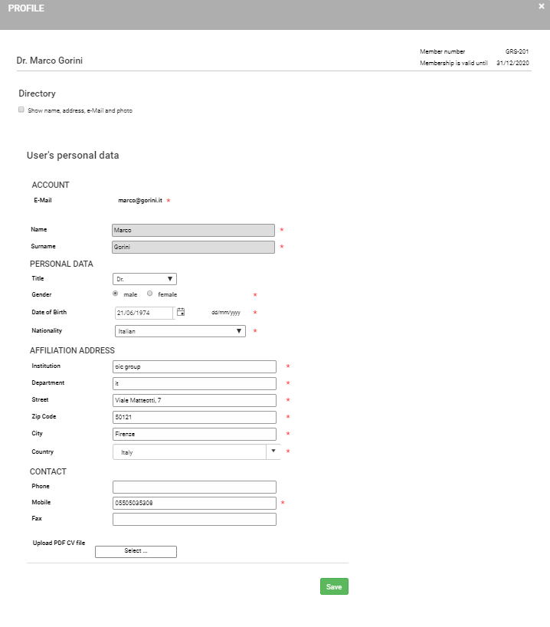
Please complete all details in your profile page, then save to continue

Slide 6
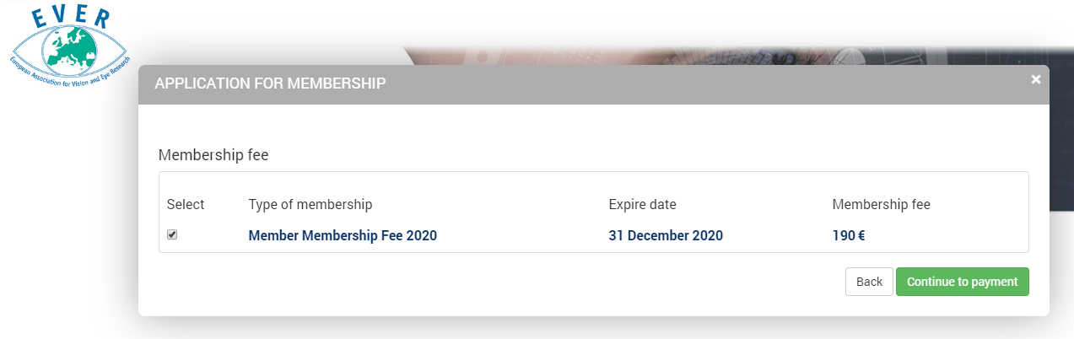
You will automatically be directed to the payment of your EVER membership dues.
Please click on continue to payment

Slide 7
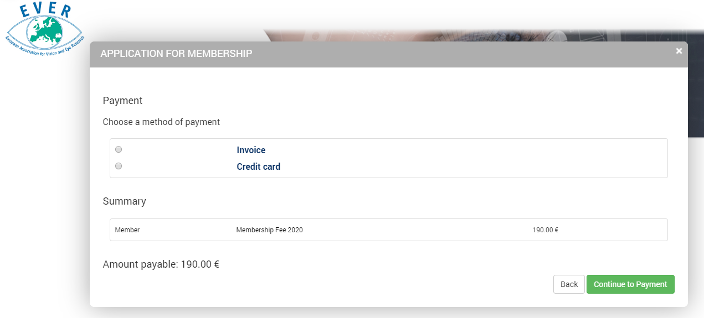
Please click «Invoice» If you wish to pay by bank trasfer
Please click «Credit Card» If you wish to pay by credit card

Slide 8
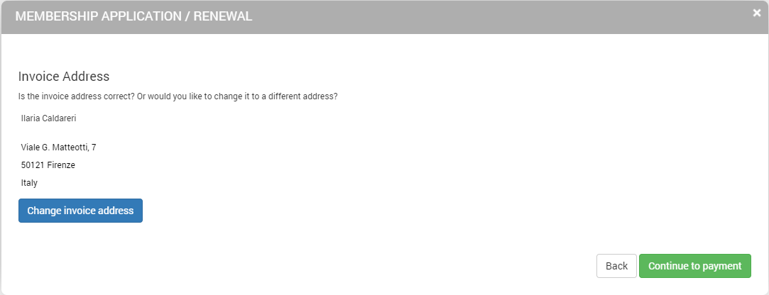
Please follow the steps and in case of a different invoice address, you may update it via the option change invoice address.
Then continue to payment

Slide 9
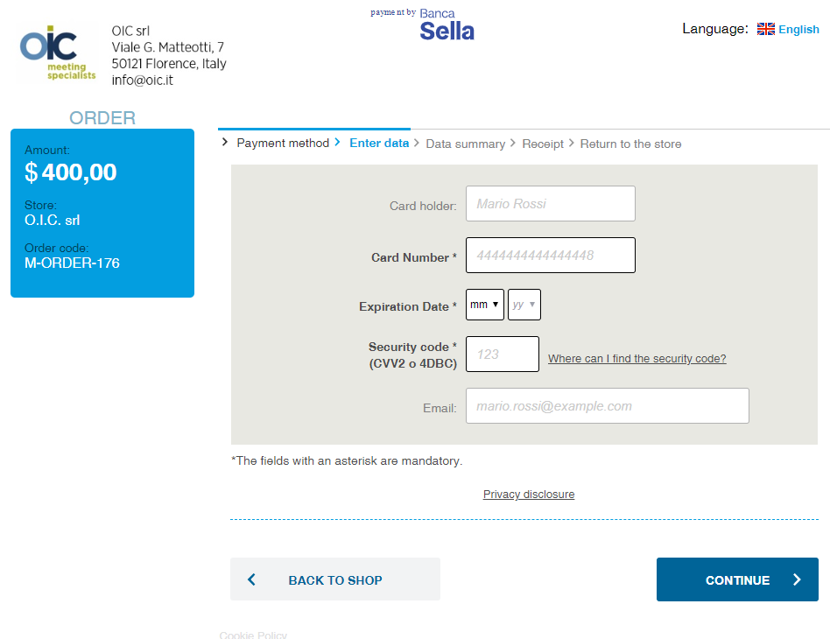
Credit Card Option:
You will then be asked to insert your credit card details and continue.
Bank Trasfer Option:
You will receive an email with a proforma invoice including bank details for payment.

Slide 10
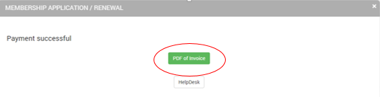
Once the payment goes through you will see the following screen where you have the possibility to print your invoice.
You will also receive a confirmation of successful payment via email.

Slide 11
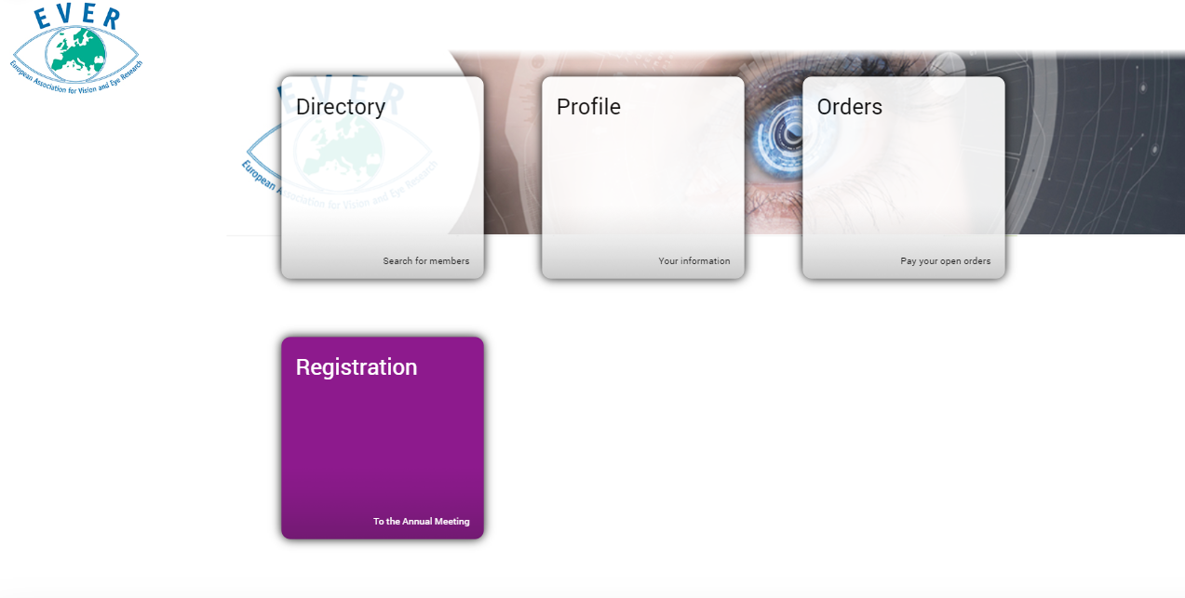
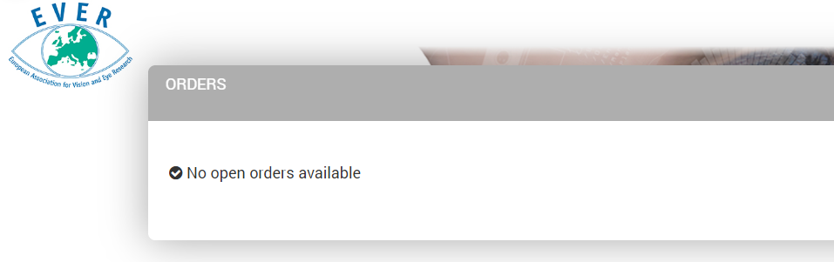
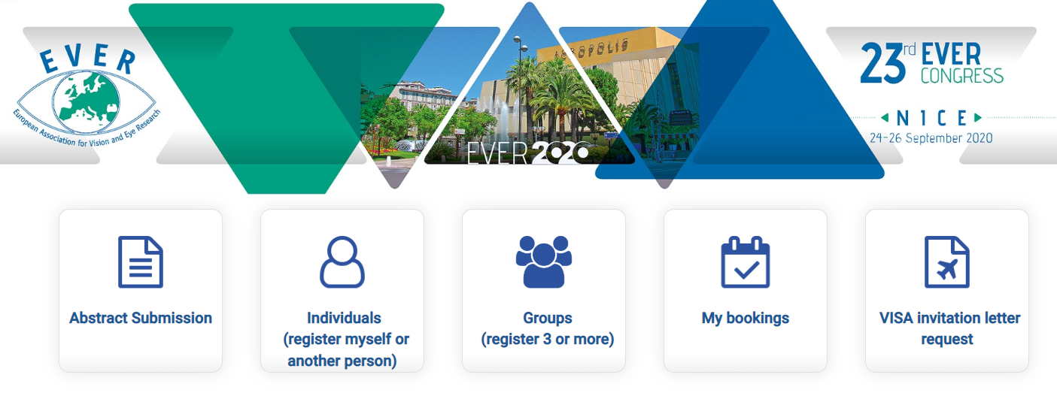
Once your membership payment is settled, you will be directed to the home page where you can update your profile details anytime and view any outstanding membership payment, if applicable.
If you click on the orders option you will notice that no further payments are due.
If you click on the registration option you will be redirected to EVER Congress registration, if applicable

